Slide 1

Fake News Detection Using Natural Language Processing (NLP)
Minor Project 2
Rahul Dhanola
Mentor – Dr Shivnaresh Shivhare

Slide 2

Index
2
S. No. | Content | Slide No.
1 | Introduction | 3
2 | Motivation | 7
3 | Literature Review | 11
4 | Methodology | 15
5 | Working Model | 18
6 | Results | 20
7 | Conclusion | 22
8 | Plan of Work | 25
9 | References | 26
Notes:
00:26
03:06
03:54
05:35
07:50
08:42
09:35
09:40

Slide 3
Introduction
3
Fake News has become one of the major problem in the existing society. Fake News has high potential to change opinions, facts and can be the most dangerous weapon in influencing society. There is no question that the web has made our lives simpler and admittance to heaps of data.
This is a development in mankind's set of experiences, and yet it unfocused the line between obvious media and vindictively manufactured media. Today anybody can distribute content - trustworthy or not - that can be consumed by the internet. Tragically, counterfeit news gathers a lot of consideration over the web, particularly via web-based media. Individuals get misled and don't reconsider circling such mis educational parts of the world. This sort of information evaporates however not without causing the damage it planned to cause.
The current project involves utilizing Machine Learning and Natural Language Processing (NLP) techniques to create a model that can expose documents that are, with a high probability, fake news articles. The outcome of this project should determine how much can be achieved in this task by analyzing patterns contained in the text and blind to outside information about the world.
Notes:
00:26
03:06
03:54
05:35
07:50
08:42
09:35
09:40

Slide 4
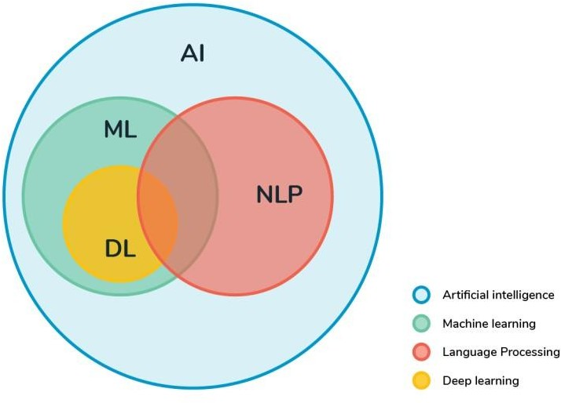
Machine Learning, Deep Learning & NLP
4
Knowing Machine Learning
Machine learning (ML) is the scientific study of algorithms and statistical models that computer systems use to perform a specific task without using explicit instructions, relying on patterns and inference instead.
It is seen as a subset of artificial intelligence. Machine learning algorithms build a mathematical model based on sample data, known as "training data", in order to make predictions or decisions without being explicitly programmed to perform the task.
Machine learning is closely related to computational statistics, which focuses on making predictions using computers.

Slide 5
Machine Learning, Deep Learning & NLP
5
Understanding Deep Learning
Deep learning is a class of machine learning algorithms that utilizes a hierarchical level of artificial neural networks to carry out the process of machine learning. The artificial neural networks are built like the human brain, with neuron nodes connected together like a web.
Deep learning architectures such as deep neural networks, deep belief networks, recurrent neural networks and convolutional neural networks have been applied to fields including computer vision, speech recognition, natural language processing, audio recognition, social network filtering, machine translation, bioinformatics, drug design, medical image analysis, material inspection and board game programs, where they have produced results comparable to and in some cases superior to human experts.
Machine learning is closely related to computational statistics, which focuses on making predictions using computers.

Slide 6
Machine Learning, Deep Learning & NLP
6
Natural Language Processing (NLP) . What’s it ?
NLP is an area of computer science and artificial intelligence concerned with the interactions between computers and human (natural) languages, in particular how to program computers to fruitfully process large amounts of natural language data.
Natural language processing (NLP) is a subfield of linguistics, computer science, information engineering, and artificial intelligence concerned with the interactions between computers and human (natural) languages, in particular how to program computers to process and analyze large amounts of natural language data.

Slide 7
Motivation
7
Fake news may be a relatively new term but it is not necessarily a new phenomenon. Fake news has technically been around at least since the appearance and popularity of one-sided, partisan newspapers in the 19th century. However, advances in technology and the spread of news through different types of media have increased the spread of fake news today. As such, the effects of fake news have increased exponentially in the recent past and something must be done to prevent this from continuing in the future.
In prior days, we used to don’t have any innovation to figure out which news is fake information and which news is the genuine. Everything they did is that, individuals will physically attempt and learn about the report from a wide range of sources whether it is a fake or genuine news. As we get the news, we don’t even have any familiarity with that news and without intentionally, we will straightforwardly consider it as a genuine news in a large portion of the cases.
The current project involves utilizing Machine Learning and Natural Language Processing (NLP) techniques to create a model that can expose documents that are, with a high probability, fake news articles. The outcome of this project should determine how much can be achieved in this task by analyzing patterns contained in the text and blind to outside information about the world

Slide 8
Problem Statement
8
To develop a Fake News Detection system using Natural Language Processing (NLP) and its accuracy will be tested using Machine Learning algorithms. The algorithm must be able to detect fake news in a given scenario.

Slide 9
Area of Application
9
Journalism
The major spread of information and trusted source is through newspapers and news channels, so this detection can be used to verify the news before broadcasting it.
Social Media
In today’s world of social media, it is easy to manipulate any information or news. Such manipulated news misguides the readers.
It is important to identify that news is fake or real. This project provides various techniques that can be used in detection and classification of information

Slide 10
Dataset & Input Format
10
The system uses a dataset of fake news articles that was gathered by using a tool called the BS detector (It is a plug-in used by Mozilla and Chrome browsers to detect the presence of fake news sources and to alert the user accordingly.) which essentially has a blacklist of websites that are sources of fake news.
The articles were all published in the 30 days between October, 26 2016 to November 25, 2016.The dataset has articles and metadata from 244 different websites, which is helpful in the sense that the variety of sources will help the model to not learn a source bias.
However, at a first glance of the dataset, you can easily tell that there are still certain obvious reasons that a model could learn specifies of what is included in the “body” text in this dataset.
For example, there are instances of the author and source in the body text , Also, there are some patterns like including the date that, if not also repeated in the real news dataset, could be learned by the model.

Slide 11
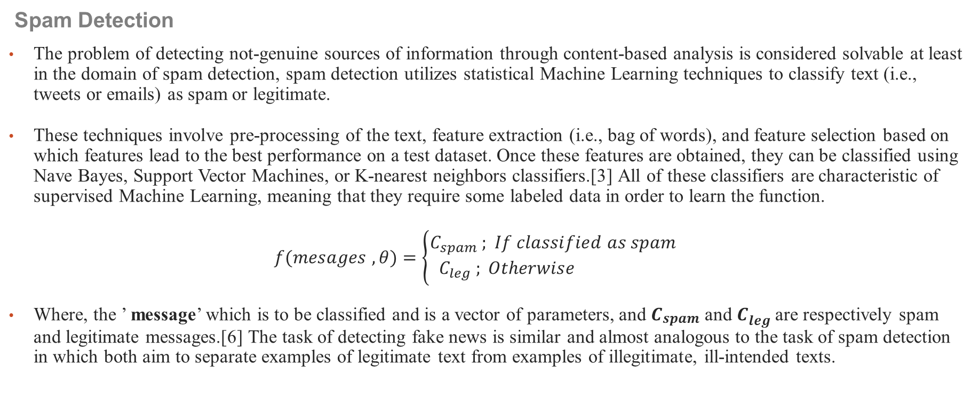
Literature Review: Related Work
11
Spam Detection
The problem of detecting not-genuine sources of information through content-based analysis is considered solvable at least in the domain of spam detection, spam detection utilizes statistical Machine Learning techniques to classify text (i.e., tweets or emails) as spam or legitimate.
These techniques involve pre-processing of the text, feature extraction (i.e., bag of words), and feature selection based on which features lead to the best performance on a test dataset. Once these features are obtained, they can be classified using Nave Bayes, Support Vector Machines, or K-nearest neighbors classifiers.[3] All of these classifiers are characteristic of supervised Machine Learning, meaning that they require some labeled data in order to learn the function.
$$f(mesages , θ)=\left\{\begin{aligned}C_{spam} ; If classified as spam \\ C_{leg} ; &Otherwise \end{aligned}\right.$$
Where, the ’ message’ which is to be classified and is a vector of parameters, and $C_{spam}$ and $C_{leg}$are respectively spam and legitimate messages.[6] The task of detecting fake news is similar and almost analogous to the task of spam detection in which both aim to separate examples of legitimate text from examples of illegitimate, ill-intended texts.

Slide 12
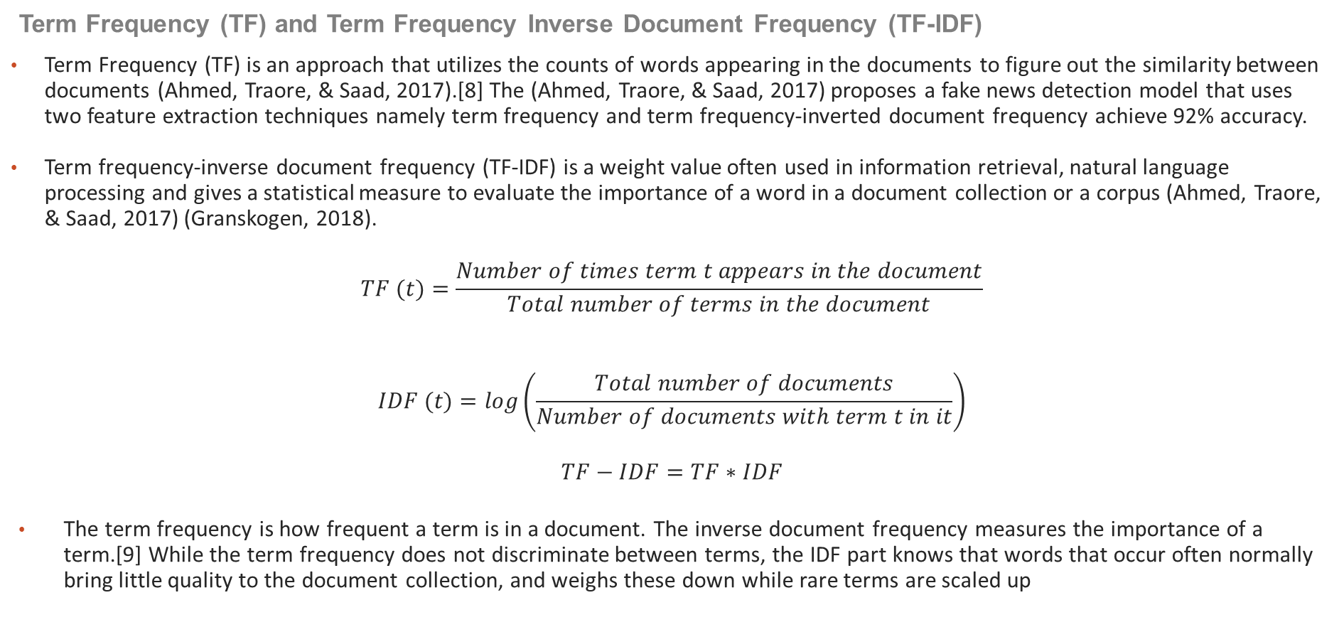
Literature Review: Related Work
12
Term Frequency (TF) and Term Frequency Inverse Document Frequency (TF-IDF)
Term Frequency (TF) is an approach that utilizes the counts of words appearing in the documents to figure out the similarity between documents (Ahmed, Traore, & Saad, 2017).[8] The (Ahmed, Traore, & Saad, 2017) proposes a fake news detection model that uses two feature extraction techniques namely term frequency and term frequency-inverted document frequency achieve 92% accuracy.
Term frequency-inverse document frequency (TF-IDF) is a weight value often used in information retrieval, natural language processing and gives a statistical measure to evaluate the importance of a word in a document collection or a corpus (Ahmed, Traore, & Saad, 2017) (Granskogen, 2018).
$$TF (t)=\frac{Number of times term t appears in the document}{Total number of terms in the document}$$
$$IDF (t)=log\left(\frac{Total number of documents}{Number of documents with term t in it}\right)$$
$$TF−IDF=TF∗IDF$$
The term frequency is how frequent a term is in a document. The inverse document frequency measures the importance of a term.[9] While the term frequency does not discriminate between terms, the IDF part knows that words that occur often normally bring little quality to the document collection, and weighs these down while rare terms are scaled up

Slide 13
Literature Review: Inference
13
Mykhailo Granik proposed simple technique for fake news detection the usage of naïve Bayes classifier. They used BuzzFeed news for getting to know and trying out the naïve Bayes classifier. The dataset is taken from Facebook news publish and completed accuracy up to 74% on test set.
Cody Buntain advanced a method for automating fake news detection on twitter. They applied this method to twitter content sourced from BuzzFeed's fake news Dataset. Furthermore, leveraging non-professional, crowdsourced people instead of Journalists presents a beneficial and much less costly way to classify proper and fake Memories on twitter rapidly.

Slide 14
Literature Review: SWOT Analysis
14
Strengths
We have used LSTM as a part of recurrent neural network it has designed for long term dependencies, therefore the idea which makes it different and unique from other neural network is that it is able to remember information for a long span of time without learning, again and again, making this whole process simpler and faster, it includes an inbuilt memory for storing information.
Weakness
We have text data around 1700 Sentences. Our data set is not sufficient enough.
Opportunities
Fake news detection is the hottest research area in deep learning. When combine with the new technology and automate approach. When used with technology like IoT (Internet when it comes to implementation of Things) allow us automate more chances to make greater profits in the detection of false text.
Threats
We did not consider unlabeled data. Hence can make model to predict incorrectly and decreasing it’s accuracy

Slide 15
Methodology
15
Proposed Method
The proposed system when subjected to a scenario of a set of news articles, the new articles are categorized as true or fake by the existing data available. This prediction is done by using the relationship between the words used in the article with one another. The proposed system contains a Word2Vec model for finding the relationship between the words and with the obtained information of the existing relations, the new articles are categorized into fake and real news.

Slide 16
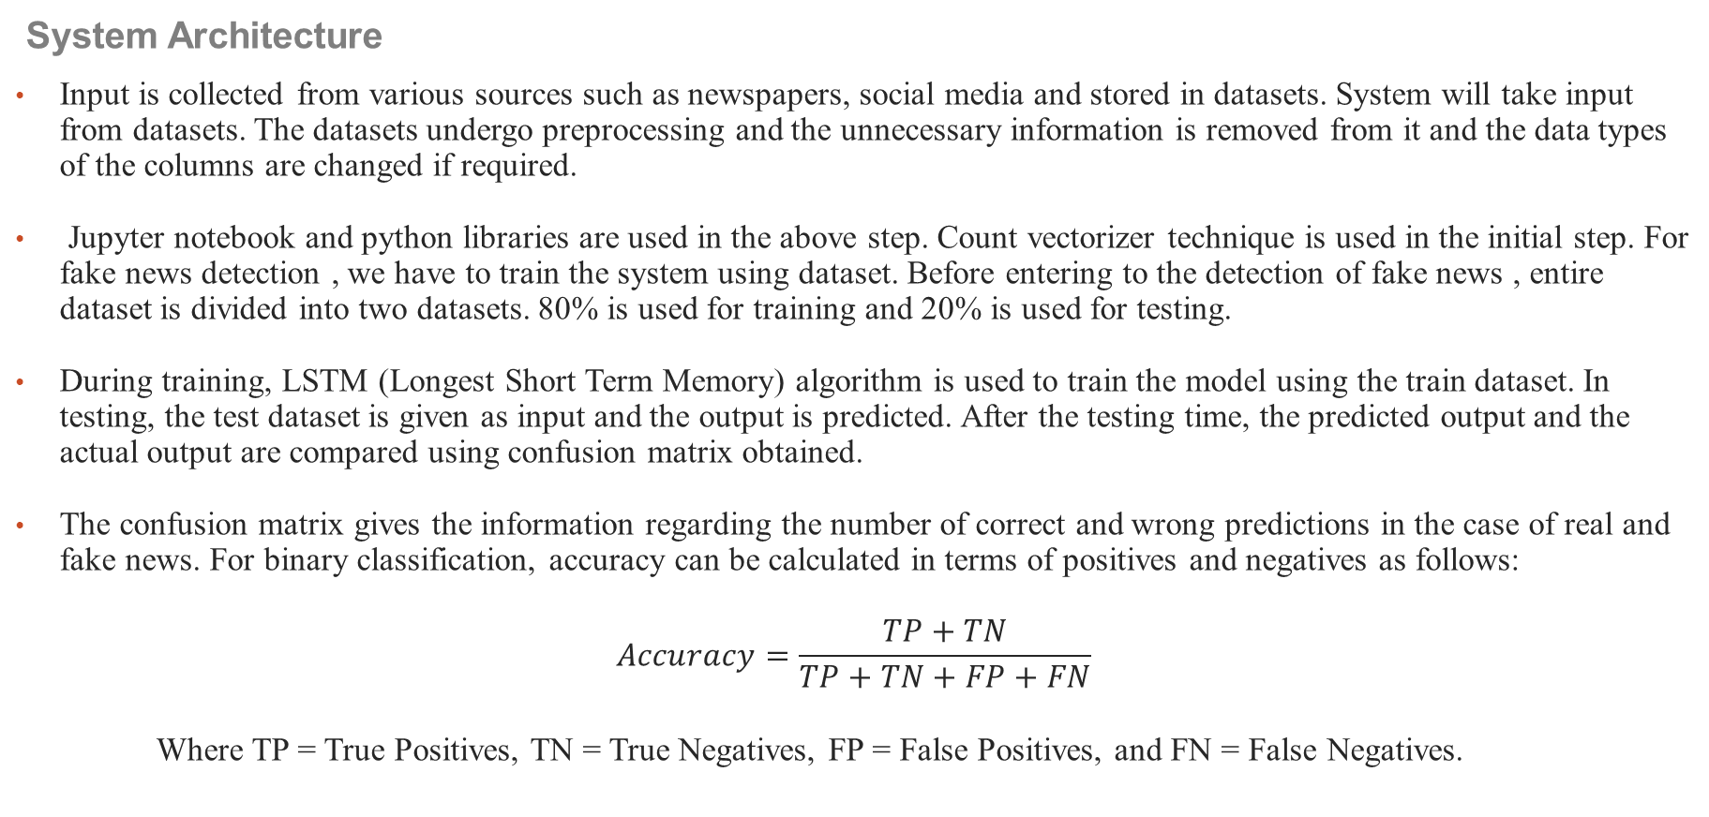
Methodology
16
System Architecture
Input is collected from various sources such as newspapers, social media and stored in datasets. System will take input from datasets. The datasets undergo preprocessing and the unnecessary information is removed from it and the data types of the columns are changed if required.
Jupyter notebook and python libraries are used in the above step. Count vectorizer technique is used in the initial step. For fake news detection , we have to train the system using dataset. Before entering to the detection of fake news , entire dataset is divided into two datasets. 80% is used for training and 20% is used for testing.
During training, LSTM (Longest Short Term Memory) algorithm is used to train the model using the train dataset. In testing, the test dataset is given as input and the output is predicted. After the testing time, the predicted output and the actual output are compared using confusion matrix obtained.
The confusion matrix gives the information regarding the number of correct and wrong predictions in the case of real and fake news. For binary classification, accuracy can be calculated in terms of positives and negatives as follows:
$$Accuracy=\frac{TP+TN}{TP+TN+FP+FN}$$
Where TP = True Positives, TN = True Negatives, FP = False Positives, and FN = False Negatives.

Slide 17
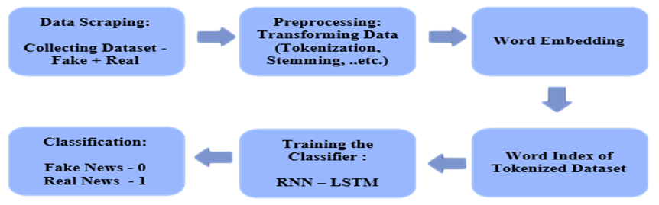
Methodology
17
Architecture flow of proposed system.

Slide 18
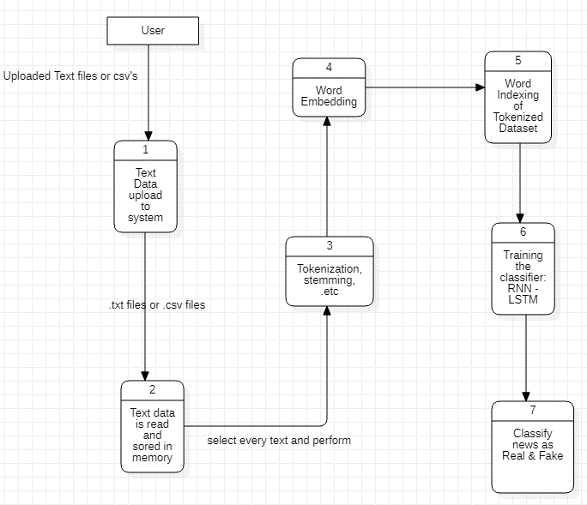
Working Model
18
Data Flow Diagram

Slide 19
Working Model
19
Requirement Analysis
Link To Software Requirement Specification

Slide 20
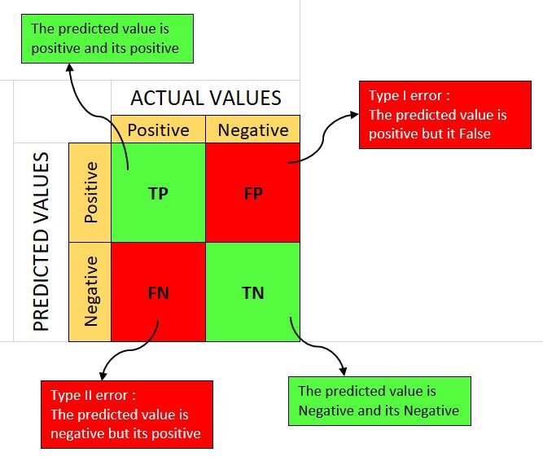
Results
20
Confusion Matrix
A confusion matrix is a table that is often used to describe the performance of a classification model (or "classifier") on a set of test data for which the true values are known. The confusion matrix itself is relatively simple to understand, but the related terminology can be confusing.
Each row of the matrix represents the instances in an actual class while each column represents the instances in a predicted class, or vice versa both variants are found in the literature.
True Positive (TP): A test result that correctly indicates the presence of a condition or characteristic.
True Negative (TN): A test result that correctly indicates the absence of a condition or characteristic.
False Positive (FP): A test result which wrongly indicates that a particular condition or attribute is present.
False Negative (FN): A test result which wrongly indicates that a particular condition or attribute is absent.

Slide 21
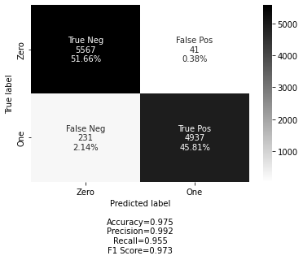



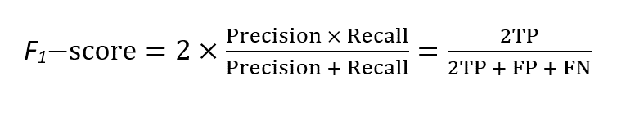
Results
21
Evaluating The Model
Some common intrinsic metrics to evaluate NLP systems are as follows:
Accuracy :- Accuracy is the number of correctly predicted data points out of all the data points.
Precision :- Precision (also called positive predictive value) is the fraction of relevant instances among the retrieved instances.
Recall :- Recall measures the proportion of actual positive labels correctly identified by the model.
F1-score: It elegantly sums up the predictive performance of a model by combining two otherwise competing metrics — precision and recall.

Slide 22
Conclusion
22
Justification of Objectives
In this project , we have predicted whether a news article is a real or fake article based on the relationship between the words .
We have used the news articles published in the 30 days between October, 26 2016 to November 25, 2016 for creation of this system
Also we have collected fake news articles from a tool called the BS detector (It is a plug-in used by Mozilla and Chrome browsers to detect the presence of fake news sources and to alert the user accordingly.) which essentially has a blacklist of websites that are sources of fake news.
We used the Word2Vec model for building model and RNN - LSTM for the prediction and obtained an accuracy of 97.47%.

Slide 23
Conclusion
23
Future Scope
We want to use web scraping in our system and get the data from various social media and websites by ourselves and use them.
We also want to improve the accuracy by query optimization.
Also we want to host the tool as an interactive website and also as a deployment behind the various services to help the customers with the various fact check.

Slide 24
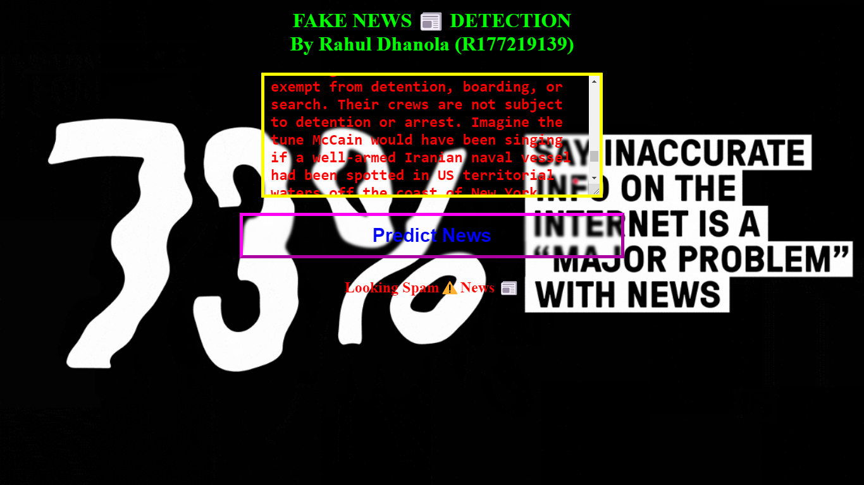
Conclusion
24
Future Scope: A Small Picture

Slide 25
Plan of Work
25
Project Timeline
Date | Expected Work
February 2022 | Research paper & feasibility understanding of the different methods used in the project. Gather all the requirements like hardware and software tools and modules for the implementation. Also collecting & understanding the required datasets.
March 2022 | Starting the Implementation part with various pre-processing steps. Arranging the data according to the model requirements. Training & testing of the model.
April 2022 | Optimizing & tuning the model parameters to increase the model accuracy. Visualization of various approaches for better understanding. Completion of the Project. Preparation of Project Report.

Slide 26
References
26
[1]. Machine learning for detection of fake news (https://dspace.mit.edu/bitstream/handle/1721.1/119727/1078649610-MIT.pdf).
[2]. Fake News Detection Documentation2.pdf (https://www.coursehero.com/file/102589219/Fake-News-Detection-Documentation2pdf).
[3]. Fake news detector: NLP project by Ishant Juyal (https://levelup.Gitconnected.Com/fake-news-detector-nlp-project-9d67e0177075).
[4]. Shloka Gilda,“Evaluating Machine Learning Algorithms for Fake News Detection” ,2017 IEEE 15th Student Conference on Research and Development (SCOReD).
[5]. Mykhailo Granik, Volodymyr Mesyura, “Fake News Detection Using Naive Bayes Classifier”, 2017 IEEE First Ukraine Conference on Electrical and Computer Engineering (UKRCON).
[6]. Gravanis, Behind the cues: A benchmarking study for fake news detection. Expert Systems with Applications, 2019.
[7]. Zhang, C., et al., Detecting fake news for reducing misinformation risks using analytics approaches. European Journal of Operational Research, 2019.
[8]. Bondielli, A. and F. Marcelloni, A survey on fake news and rumour detection techniques. Information Sciences, 2019.
[9]. Alirezaei, M., S.T.A. Niaki, and S.A.A. Niaki, A bi-objective hybrid optimization algorithm to reduce noise and data dimension in diabetes diagnosis using support vector machines. Expert Systems with Applications, 2019.
[10]. Fake News Detection using LSTM Tejaswini Yesugade, Shrikant Kokate, Sarjana Patil, Ritik Varma, Sejal Pawar. e-ISSN: 2395-0056

Slide 27
Thank You
27
27

